Slide 1
iOS Automation

Slide 2
Agenda
Locators in iOS
PickerWheel Automation
Multi region & Language Testing

Slide 3
Locators & IOS

Slide 4
XPath & iOS
We no longer recommended using the FindElementByXPath() method for iOS Devices running iOS 10 or later.
Apple has released a new test automation infrastructure – XCUITest
XPath queries on iOS 11+ will be slow & may cause performance issues
Fortunately, Appium offers different FindElement flavors
Creating custom locators for iOS with the correct strategies is fast & reliable.
Notes:
Apple has introduced a new standard for working with iOS devices. While XPath still works, it is slower and not guaranteed to work in future iOS versions.
The new methods for identifying objects are faster and aligned to Apple’s best practices.
There are several options, which we will walk through.

Slide 5
The Alternative is ….
There are several alternatives to XPath
All are similar and contain the same basic principle – identifying an element in a short readable way.
The various options are dependent on the application being tested.
For ID’s to be identified they must exist in the code
We will look at the options in order of performance.
Remember … study your application before deciding on the method to use.
You can choose more than one!

Slide 6
Other FindElement Types
Appium offers different By options for the FindElement, in addition to the By.Xpath option.
Basic Alternatives
FindElementByClassName() – uses the elements class name, e.g. XCUIElementTypeButton.
FindElementByName() or FindElementByAccessibilityID() – both use the identifier property of the element.
FindElementByLinkText() – uses the label property value of the element.
Advanced Alternatives
FindElementByIosNSPredicate() – supports logical combinations of search criteria.
FindElementByClassChain() – supports chaining of search criteria to search for children of an element.

Slide 7
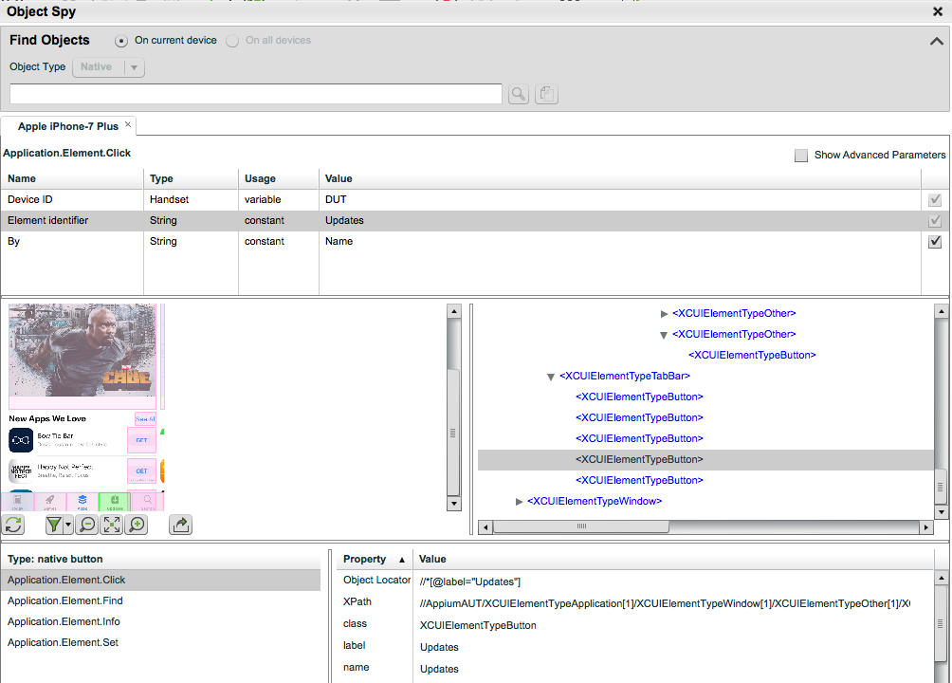
Using the Object Spy
The Spy contains the info we need
We need to use it in a new way.
Notes:
Open the object Spy & demonstrate on it.
Show that the information – className, name, accessibilityID are visible in the Object spy.

Slide 8
Why are there different methods?
We will look at several strategies for identifying objects
There are multiple options because Appium supports it & the best fit depends on how the application is written.
The strategies are presented in order of performance
Any one you select will be fine and superior to XPath
Learn your app before you start
Remember that you can use multiple strategies!

Slide 9
className
The className identifies the object according to the class
The class, e.g. XCUIElementTypeButton, is frequently NOT Unique.
The identification is therefore per page e.g.
If you are looking for the 2nd button on the page you can
Get the list of elements with that class with the FindElements method
Then select the required object, by indexing into the list.
The main disadvantage is dependency of the object to the relationship to other objects in the page.

Slide 10
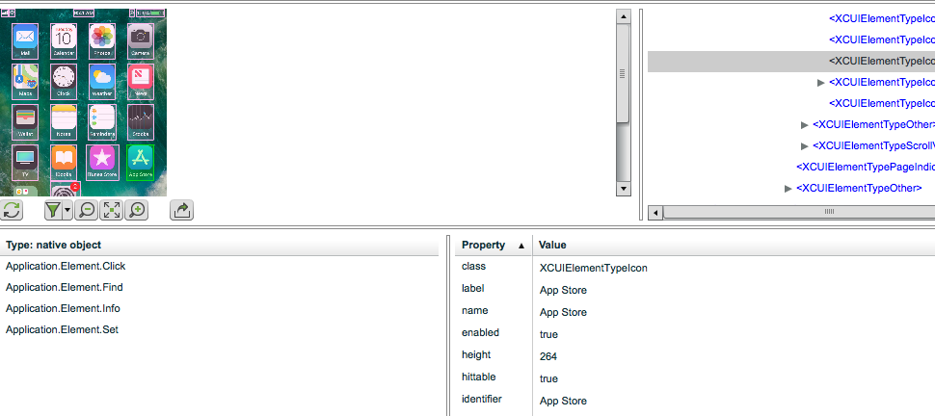
Identifier
The Identifier property is a unique identity of the object.
It is easy to find in the Object Spy & simple to define
Usage requires the developer to define an identifier per object.

Slide 11
Name
The Name property is equal to the identifier and can also be used
driver.FindElementByName(“App Store”);
// OR
driver.FindElementByAccessibilityId(“App Store”);

Slide 12
linkText
Captures the name attribute value automatically
Like identifier & name – easy to recognize & define
This method also makes sense in terms of user experience, i.e. you define the link the user will click on.
driver.FindElementByLinkText('My Link');

Slide 13
Advanced Methods
Predicate Queries allow constructing a query similar to XPath
They are a logical statement that describe the object Type == 'XCUIElementTypeButton' AND value BEGINSWITH[c] 'bla' AND visible == 1
classChain is similar, with a different syntax and allows building a complete hierarchical statement.
We will not delve into these 2 options as the simpler methods shown before are adequate for the need. Users who are already familiar with these advanced methods are free to use them.

Slide 14
Are you confused?
It is simpler than it looks. Follow these guidelines:
Check your application. What attributes are defined for the elements?
Try to use either the object’s identifier, name, or linkText
Use the className if needed, just remember the element’s className is not unique.
The Predicate & classChain options are for advanced users only.

Slide 15
Picker Wheel Automation

Slide 16
Selecting Values in Picker wheel
The Picker Wheel is commonly used in iOS for selecting dates and other data inputs.
There are 2 methods for interacting with the wheel, depending on how the element was developed:
Title For Row - The Picker Wheel values are defined as a String In this case a simple SendKeys method is sufficient element.SendKeys("title");
View for Row - The Picker Wheel Values are defined as a view This requires scrolling to the required value See - https://developers.perfectomobile.com/display/TT/PickerWheel+Automation
Notes:
The Picker Wheel is a common hurdle in many applications.
We’ll look at 2 samples here – one when the wheel is defined as a String and one when it is a value.
Unfortunately there is no way to know from the application what type of wheel it is as this is a backend property. Therefore it is best to try the title option first.
Since Title rows are much easier to automate, you should inform your Dev team of this for them to take this into account.

Slide 17
Picker wheel Sample
Show & Run the sample on the iOS Calendar app
We will be extending this sample in the assignment

Slide 18
Multi Language & Region

Slide 19
Multi Region & Language Testing
Applications that have a global customer base are available in many languages.
Setting the language & region is easily done through the capabilities and provides the ability to run tests for the entire install base.
This is an iOS only feature
capabilities.SetCapability("language", "es"); // language is Spanish capabilities.SetCapability("locale", "es_UY"); // region is (Uruguay)

Slide 20
Robust iOS Executions

Slide 21
Robust iOS Tests – Execution Time
The iOS driver develops memory issues on the device during long executions. To avoid this problem Perfecto recommends:
Split test executions into shorter driver sessions.
For customers using only iPad Pro or iPhone 7 or newer devices driver sessions should not exceed 2 hours
For customers running tests also on older devices, driver sessions should not exceed 1 hour.
The term driver session refers to the time period from the point of IOSDriver creation until the point in which driver is closed.

Slide 22
Resources
​Finding elements - https://developers.perfectomobile.com/display/TT/Finding+Elements+on+XCUITest+devices
XCUITest Automation - https://developers.perfectomobile.com/display/TT/XCUITest+Automation
Predicate Queries - https://github.com/facebook/WebDriverAgent/wiki/Predicate-Queries-Construction-Rules
Picker Wheel - https://developers.perfectomobile.com/display/TT/PickerWheel+Automation

Slide 23
Assignment
Extend the calendar sample and add the following to it:
A monthly Event
Add end date a year and 3 months ahead.
Event Ends at 11:15
Add travel time of 2 hours to the event.

Slide 24
Thank You

